Slide 1

Computer Graphics
Dr. Lucy J. Gudino
Computer Science & Information Systems Group
Birla Institute of Technology & Science, Pilani, Goa Campus

Slide 2
Problem
Create following vertices
v1 = (100, 100)
v2 = (150, 300)
v3 = (200, 100)
v4 = (300, 250)
v5 = (400, 200)
v6 = (450, 100)
v7 = (500, 150)

Slide 3
Point Details
glPointSize(GLfloat size);
  Sets the width in pixels for rendered points; size must be greater than 0.0 and by default is 1.0.
  If size = 1.0, the square pixel is 1 pixel by 1 pixel
glGetFloatv(GL_POINT_SIZE_RANGE,sizes);
  Sizes is the two dimensional array in which range of point size will be returned

Slide 4
Contd…
With antialiasing enabled, a circular group of pixels is drawn, and the pixels on the boundaries are typically drawn at less than full intensity to give the edge a smoother appearance.
In this mode, non-integer widths aren’t rounded.
glEnable(GL_POINT_SMOOTH);

Slide 5
Line Details
void glLineWidth(GLfloat width);
  Sets the width in pixels for rendered lines; width must be greater than 0.0 and by default is 1.0.
To obtain the range of line width
glGetFloatv(GL_LINE_WIDTH_RANGE,sizes);
  Sizes is the two dimensional array in which range of line width will be returned

Slide 6
OpenGL Line Functions
To draw lines → GL_LINES
  glBegin ( GL_LINES );
  glVertex2i (180,20);
  glVertex2i (280,20);
  glEnd;
To draw polyline → GL_LINE_STRIP
  Draws a line segment from v0 to v1, then from v1 to v2, and so on, finally drawing the segment from vn-2 to vn-1. Thus, a total of n-1 line segments are drawn.

Slide 7
OpenGL Polygon functions
GL_POLYGON : Draws filled polygon
  Polygons are the areas enclosed by single closed loops of line segments, where the line segments are specified by the vertices at their endpoints. P
glBegin (GL_POLYGON);
glVertex2iv (p1);
glVertex2iv (p2);
glVertex2iv (p3);
glEnd();

Slide 8
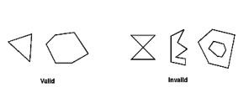
Contd…
Restrictions:
the edges of OpenGL polygons can’t intersect (Simple polygon)
polygons must be convex
polygons with holes can’t be described.

Slide 9
GL_LINE_LOOP
  Same as GL_LINE_STRIP, except that a final line segment is drawn from vn-1 to v0, completing a loop.
GL_TRIANGLES
  Draws a series of triangles (three-sided polygons) using vertices v0, v1, v2, then v3, v4, v5, and so on. If n isn’t an exact multiple of 3, the final one or two vertices are ignored.

Slide 10
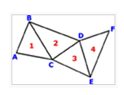
GL_TRIANGLE_STRIP
  Draws a series of triangles (three-sided polygons) using vertices
  Used in Reversing and Culling Polygon Faces

Slide 11
GL_TRIANGLE_FAN
  Same as GL_TRIANGLE_STRIP, except that the vertices are v0, v1, v2, then v0, v2, v3, then v0, v3, v4, and so on
GL_QUADS
  Draws a series of quadrilaterals (four-sided polygons) using vertices v0, v1, v2, v3, then v4, v5, v6, v7, and so on. If n isn’t a multiple of 4, the final one, two, or three vertices are ignored.

Slide 12
GL_QUAD_STRIP
  Draws a series of quadrilaterals (four-sided polygons) beginning with v1, v2, v4, v3, then v3, v4, v6, v5, then v5, v6, v8, v7, and so on. n must be at least 4 before anything is drawn. If n is odd, the final vertex is ignored.

Slide 13
Drawing filled rectangle
glRecti (x1, y1, x2, y2);
Ex: glRecti (200,100, 50, 250);
Or
int v1 [] = {200, 100};
int v2 [] = {50, 250 };
glRectiv (v1, v2);

Slide 14
Color
glClearColor : to set the background color
  Ex: glClearColor(R, G, B, Alpha)
  Alpha value acts as a blending parameter
    Used to determine the resulting color of two overlapping objects
    1.0 -> opaque object
    0.0 -> transparent object

Slide 15
Contd…
void glClear(GLbitfield mask);
Bitwise OR of masks that indicate the buffers to be cleared. The three masks are GL_COLOR_BUFFER_BIT, GL_DEPTH_BUFFER_BIT, and GL_STENCIL_BUFFER_BIT.
  GL_COLOR_BUFFER_BIT :Indicates the buffers currently enabled for color writing.
  GL_DEPTH_BUFFER_BIT: Indicates the depth buffer.
  GL_STENCIL_BUFFER_BIT: Indicates the stencil buffer.
Stencil buffer is used to block certain portion of the scene

Slide 16
Contd…
To set color scheme for the objects
  glColor3f(R, G, B)
  glColor3f(1.0, 0.0, 0.0) ➔ red
  glColor3f(0.0, 1.0, 0.0) ➔ green
  glColor3f(0.0, 0.0, 1.0) ➔ blue

Slide 17
Example
glEnable(GL_POINT_SMOOTH);
glPointSize(10);
glBegin (GL_POINTS);
glColor3f ( 1.0, 0.3, 0.2);
glVertex2i( 0, 0 );
glVertex2i( 100, 100 );
glVertex2i( 100, -100 );
glVertex2i( -100, 100 );
glVertex2i( -100, -100 );
glEnd();

Slide 18
Contd..
Change this line
  gluOrto2D (0, 750, 0, 750);

Slide 19
Functions
Coordinate reference frames
  Picture in Cartesian coordinate system → world coordinate reference frame
    Two dimensional
    Three dimensional
  To draw a line segment
    Two end points
    Color
    Coordinate extends : Minimum and maximum x, y, z values of an object
      Also known as bounding box for an object
      For two dimensional object → bounding rectangle

Slide 20
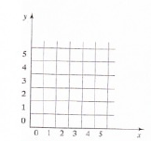
Contd…
Screen Co-ordinates
  Locations on a video monitor → integer
  Once pixel position is identified, the appropriate color values must be stored in frame buffer
    setPixel (x, y); stores the current color setting into the frame buffer at integer position (x,y)
    getPixel(x,y,color); parameter color receives an integer value corresponding to the RGB bit codes at position (x,y)

Slide 21
Specifying a two dimensional world-coordinate reference frame in OpenGL
Note: two dimensional picture is treated by openGL as a special case of three dimensional line
gluOrto2D (xmin, xmax, ymin, ymax);
  Specifies Ortogonal projection
  Gives the x, y coordinate limits for the picture to be displayed

Slide 22
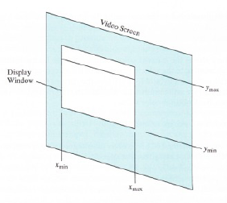

Contd…
  gluOrto2D (0.0, 200.0, 0.0, 150,0);
  Ortogonal projection is to be used to map the contents of a two dimensional (2D) rectangular area of world coordinates to the screen (with x – coordinate 0.0 to 200.0 and y-coordinate 0.0 to 150.0)
  Anything outside this range will not be displayed

Slide 23
2-D Transformations
glBegin (GL_POLYGON);
glColor3f ( 1.0, 0.3, 0.2);
glVertex2i( 0, 0 );
glVertex2i( 50, 0 );
glVertex2i( 50, 50 );
glVertex2i( 0, 50 );
glEnd();

Slide 24
2D Transformations
Translation (in the x or y directions):
glTranslatef(tx, ty, 0.0);
Rotation (theeta about the z-axis):
glRotatef(theeta, 0.0, 0.0, 1.0);
Scaling (in the x or y directions):
glScalef(Tx, Ty, 1.0);

Slide 25
State Management
OpenGL maintains many states and state variables
GL State Variables- can be set and queried by OpenGL. Remains unchanged until the next change.
  States include :
    colour and other primitive attributes
    the current matrix mode
    the elements of model view matrix
    the current position for the frame buffer
    the parameters for the lighting effects in a scene
States affect the appearance of an object
  Lighting, texture, color etc.

Slide 26
contd…
To turn on and off many of these states, use these two simple commands:
  void glEnable(GLenum cap);
  void glDisable(GLenum cap);
  where cap specifies a symbolic constant indicating a GL capability.
Example:
glEnable(GL_POINT_SMOOTH);

Slide 27
State Variable | Description | Attribute Group | Initial Value | Get Command
GL_CURRENT_TEXTURE_COORDS | Current texture coordinates | current | 0, 0, 0, 1 | glGetFloatv()
GL_CURRENT_COLOR | Current color | current | 1, 1, 1, 1 | glGetIntegerv(), glGetFloatv()
GL_MODELVIEW_MATRIX | Modelview matrix stack | - | Identity | glGetFloatv()
GL_FOG_COLOR | Fog color | fog | 0, 0, 0, 0 | glGetFloatv()
GL_POINT_SIZE | Point size | point | 1.0 | glGetFloatv()
GL_POINT_SMOOTH | Point antialiasing on | point/enable | GL_FALSE | glIsEnabled()

Slide 28
Point Details
glPointSize(GLfloat size);
  Sets the width in pixels for rendered points; size must be greater than 0.0 and by default is 1.0.
  If size = 1.0, the square pixel is 1 pixel by 1 pixel
glGetFloatv(GL_POINT_SIZE_RANGE,sizes);
  Sizes is the two dimensional array in which range of point size will be returned

Slide 29
Contd…
With antialiasing enabled, a circular group of pixels is drawn, and the pixels on the boundaries are typically drawn at less than full intensity to give the edge a smoother appearance.
In this mode, non-integer widths aren’t rounded.
glEnable(GL_POINT_SMOOTH);

Slide 30
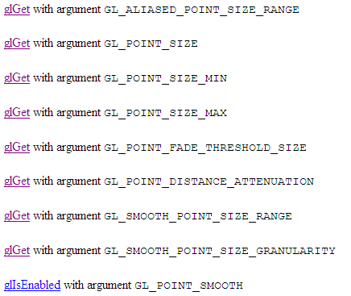
Contd…

Slide 31
Line Details
void glLineWidth(GLfloat width);
  Sets the width in pixels for rendered lines; width must be greater than 0.0 and by default is 1.0.
To obtain the range of line width
glGetFloatv(GL_LINE_WIDTH_RANGE,sizes);
  Sizes is the two dimensional array in which range of line width will be returned

Slide 32
Stippled Lines (dotted or dashed)
To make stippled (dotted or dashed) lines, you use the command glLineStipple() to define the stipple pattern, and then you enable line stippling with glEnable().
void glLineStipple(GLint factor, GLushort pattern);
pattern: 16 bit series of 1’s and 0’s
factor: stretching factor , lie between 1 and 255.

Slide 33
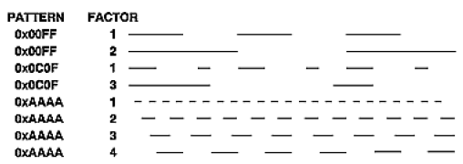
Contd

Slide 34
Contd…
a stippling pattern continues across a series of connected line segments within glBegin() and glEnd()

Slide 35
Buffers
Four Buffers:
  Color buffers
  Depth buffer
  Stencil buffer
  Accumulation buffer
void glGetIntegerv(GLenum pname, GLint * params);
  pname: Specifies the parameter value to be returned. The symbolic constants in the list below are accepted.
  params: Returns the value or values of the specified parameter.

Slide 36
